Slide 1

Stock Market analysis and prediction
Group Members:
Suman pokhrel(coordinator)
Laxmi kanta dahal
Nidhi gupta

Slide 2
Objective of the project
The main Objective of our project is to consider several Data of past and present and provide predictions that are accurate enough for practical implementations.

Slide 3
demo
Before actually going to the Project workflow lets know what the program actually looks like when its running on a machine.

Slide 4
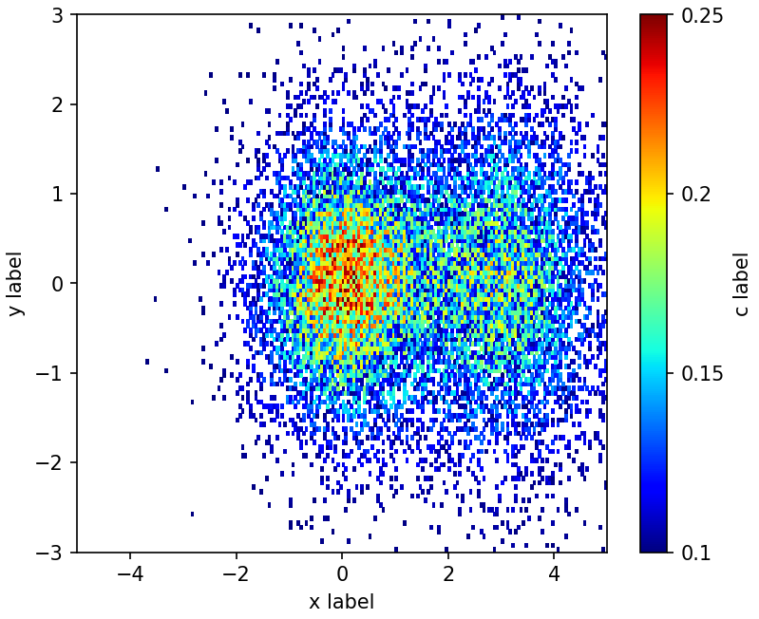



Tools used
Python(version less than 3.8)
pandas
Matplotlib

Slide 5
Basic terms
Artificial intelligence: Stock Analysis:
Machine learning: Fundamental analysis
Deep learning: Technical analysis
Artificial Neural network:

Slide 6
Workflow of the program
Building the LSTM model
Using Keras Sequential class’s .add function
Training the model using tensorflow as backend
Using fit function
Make prediction
Using the model on the testing data
Visualizing the outcome
Using the matplotlib module
Importing Modules
Data Extraction
From web
Using the Pandas module so extract data from the website and store it in a DF
Data Preprocessing
Such as:
Numpy
Pandas
Matplotlib….
…
1Converting the DF into the Numpy array..
2.Spliting the data set into training data and testing data
3.Scaling the data range to ( 0 to 1)
4.Reshaping the data to 3D form for LSTM model

Slide 7

Clearing out some basic questions
Why even use AI for this purpose?
Why choose ANN rather than simple regression based Algorithm?
Why choose LSTM over other NN?

Slide 8

Thank You
2018012854.suman@ug.sharda.ac.in

